Slide 1

Presentation Tools & Training Wheels
Presentations Tips and Tricks

Slide 2

Presentations Can Be Stressful
but they don’t have to be! Each page will show you an
example of ways to enhance your slide decks

Slide 3
NAV BAR | Highlighting | Text | Icons | Photos | Space | Why
Add A Navigation Bar
It will help you get organized and your viewers will better understand your presentation and thought process!

Slide 4
Nav Bar | HIGHLIGHTING | Text | Icons | Photos | Space | Why
Highlight Your Point…Literally
Draw people’s attention to important issues or things you would like to make obvious by calling out a specific piece of information with a pop of color. Which chart did you first pay attention to when you looked at this page?
10% Made You Look
Customer Response Adoption - Lower
Customer Response Adoption - Lower

Slide 5
Nav Bar | HIGHLIGHTING | Text | Icons | Photos | Space | Why
Data Doesn’t Always Mean Graphs
You can express text and numbers through visuals other than your typical PowerPoint graphs.
8 out of 10
Will absolutely love
this presentation

Slide 6
Nav Bar | Highlighting | TEXT | Icons | Photos | Space | Why
Please don’t do this with your text- this is an example of what not to do:
Text is important, but know when, where and how to use it. First decide what text should be the largest font size (create hierarchy) then use space to distribute the text on to the page so that it’s easiest to read. Maybe throw in a line here and there, but don’t bullet point everything
Which one of these text groupings do you prefer?
Which is the easiest to read?
Why do you think this is the case?
Balance Your Text
Text is important but know when, where and how to use it. First decide what text should be the largest font size (create visual hierarchy) then use space to distribute the text on to the page so that it’s easiest to read. Throw in a line here and there, but don’t bullet point everything:
Which one of these text groupings do you prefer?
Which is the most pleasing to read?
Why do you think this is the case?

Slide 7



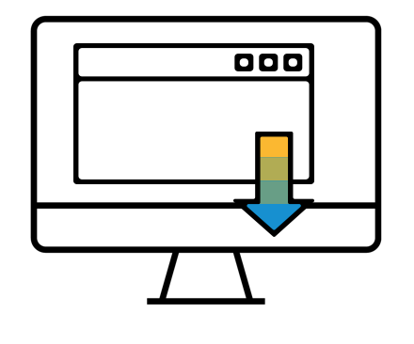

Nav Bar | Highlighting | Text | ICONS | Photos | Space | Why
Visualize Your Point with Icons
It’s a great way to bring interest to a page
and icons can organize many ideas, into one image
get them here!
https://www.sapbrandtools.com/imagelibrary/index.html#/

Slide 8

Nav Bar | Highlighting | Text | Icons | PHOTOS | Space | Why
Visuals Increase Retention By 42%.
-the internet.

Slide 9
Nav Bar | Highlighting | Text | Icons | Photos | SPACE | Why
Less is More…
..on a page! Slide space is limited but slides are free. Try to use more slides to
de-clutter your presentation. SPACE is just as important as text. Look at all this negative space . . . doesn’t it just let you, breath . . .

Slide 10
Nav Bar | Highlighting | Text | Icons | Photos | SPACE | Why
Too Much Info & Not Enough Time
We know. But make it look like you’re not rushing by removing some of the chunkiness of a solid box. Try using lines, more space, and some direction
3 Elements of Design
3 Elements of Design
Elements
Space
Color
Shape
Space
Color
Shape
Negative
Positive
Tight vs loose
Bright/bold
monochromatic
primary
Rectangle
Circle
star
Negative
Positive
Tight vs loose
Bright/bold
monochromatic
primary
Rectangle
Circle
star

Slide 11

Helpful links:
Download this power point!
Brand images/icons:
https://www.sapbrandtools.com/
Free professional photos:
https://unsplash.com/
Forbes on presentations
https://www.forbes.com/sites/allbusiness/2013/11/25/7-principles-for-making-powerpoint-slides-with-impact/#66dc20b44d03
How to tell a good story
https://www.mckinsey.com/featured-insights/innovation-and-growth/telling-a-good-innovation-story?cid=other-eml-alt-mkq-mck-oth-1807&hlkid=6744fb5ebc5844478b32b9712b4030ed&hctky=2504181&hdpid=99dd2036-a0bf-4f88-94c0-21182bcaca55
Nav Bar | Highlighting | Text | Icons | Photos | Space | WHY
Wake Up Your Viewers
“Design isn’t just about beauty; it’s about market relevance and meaningful results.” Design in Tech Report 2017

Slide 12





USING TEXTURE | Animation | Consistency | Adding Context | Caution! | More Help
Add Texture with Gradients
Use these shapes made with gradients or make your own (see the last shape) to make your information pop and look more professional.
You Can Make These Too!
1. Add a gradient by right clicking the shape, click format shape, fill gradient (for more subtly gradients use lighter shades)
2. Copy the first shape, enlarge, flip and send to the background to give illusion of a bevel
3. Add a drop shadow to give it depth and a pop!

Slide 13
Using Texture | ANIMATION | Consistency | Adding Context | Caution! | More Help
Deep Dive by Adding Depth with Animation
By adding “animation layers” to your graphics you can keep the focus on what you want to talk about, when you want to talk about it. Highlight your first point, then fade it out while highlighting your next! Click “present” and then click through to view full example.
People Who Love Design
Metro Ticket Machines
6%
Darth Vader
23%
71%
Customers
Customers

Slide 14
Using Texture | Animation | CONSISTENCY | Adding Context | Caution! | More Help
Consistency is Key
Make your customer feel understood and special by consistently representing your data throughout your presentation. For example in this presentation the customer is always represented in gold.
Key Metrics, Company Performance
Data Centers
Business Satisfaction Rating
Rank |  | Company Value | Metric | Peer Group
 |  | 27,035.00 | Revenue per Employee | 27,007.50 |  | 40,112.30
 |  | 5.00 | Revenue Growth (in %) | 6.40 |  | 11.00
 |  | 100.00 | Operating Margin (in %) | 9.20 |  | 14.00
Top
25%
Average
6.30
7
7
6
Bottom
25%
Ranking:
Below Average
Between Average and Top 25%
Top 25%
0
Customers
7
1 = No Coverage
5 = Full Coverage

Slide 15


Using Texture | Animation | CONSISTENCY | Adding Context | Caution! | More Help
This Whole Document is Consistent Too?!
The line weight, font type, colors, and language tense is consistent throughout this document. Consistency in any work can make something look, sound and feel more professional.
The Design Exception
The color of the font on this slide, slide 6 and slide 7 is different so that you can read it.
Function over form always!!

Slide 16


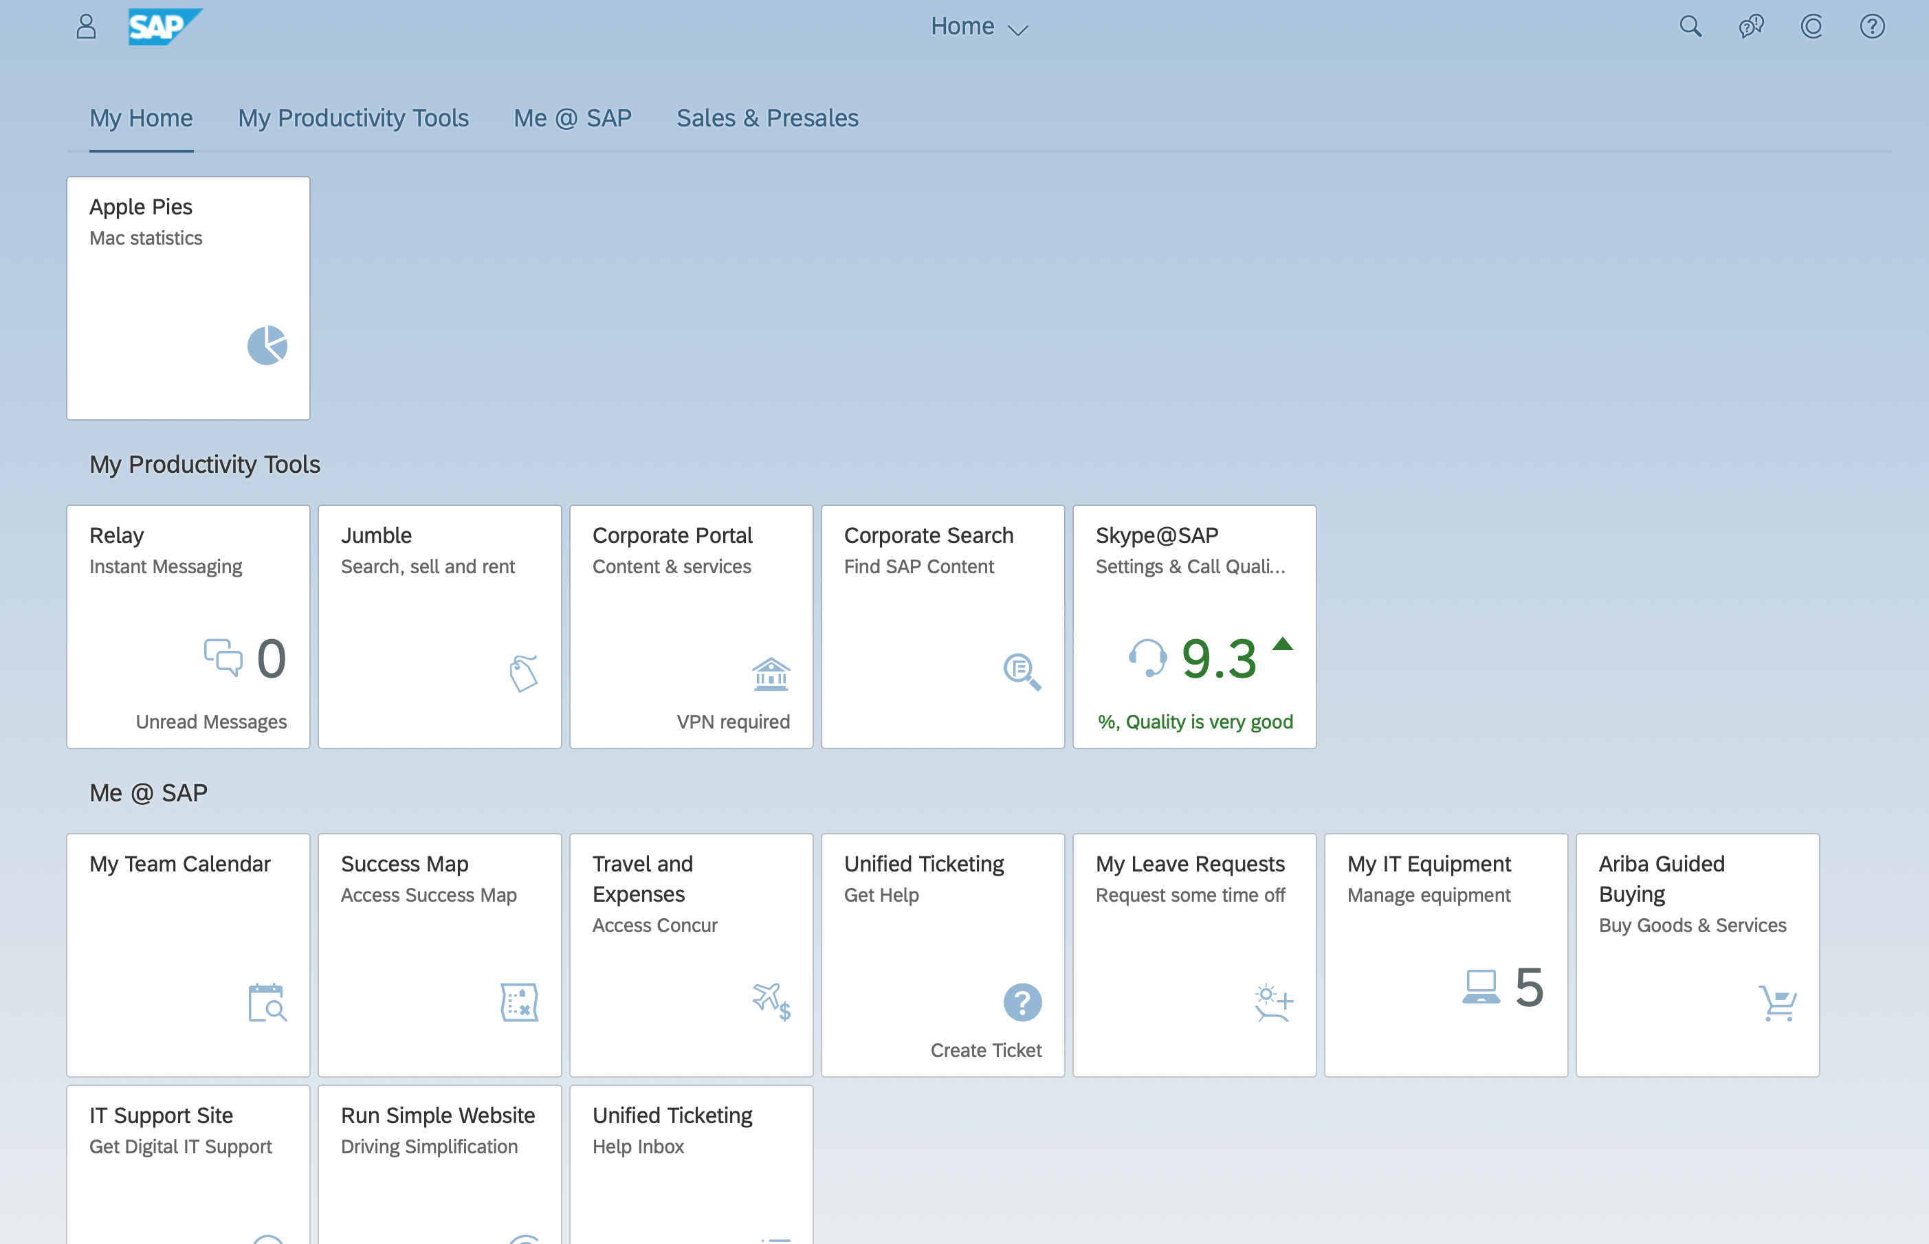

Put things into Context
Has any one ever randomly started talking to you about something they assumed you already knew? That’s how it can feel when someone is just looking at a screen capture of a program..
Using Texture | Animation | Consistency | ADDING CONTEXT | Caution! | More Help
Give Things Some Context
Try not to assume that people know what you’re talking about. Put your demos or screenshots in a mockup to give your work more impact and meaning.
Place Image in Front
Place Image in Back
Place Image in Back

Slide 17


Using Texture | Animation | Consistency | Adding Context | CAUTION! | More Help
Take Precaution!
Be aware that PCs and Macs aren’t exactly compatible when it comes to Microsoft. You may have experienced this with this presentation. Presentations made on Macs (like this one) may look different when said presentation is open in a PC.
Be Sure to Double Check
Fonts, shapes and photos may scale, shift and load differently than intended. For best results export your FINAL presentations as PDFs.

